Slide 1
Designing and Implementing Distributed, Service Based Architecture
Instructor: Kim R Fowler
Course date:
Monday 23rd to Wednesday 25th January 2017
.

Slide 2
About You
Your name
Your Job
Your expectations for the course
Copyright KPL KnowledgeSolutions Ltd – All rights reserved

Slide 3
Chapter 1: The State of Systems

Slide 4
In the Past …
… in a galaxy far, far away …
Most systems were built around monolithic codebases
Even if accessed by network protocols
This was seen as a way of working to improve re-use
And share a standard skillset
Or at least that was the logic
Sadly, that galaxy is here … And now.
Copyright KPL KnowledgeSolutions Ltd – All rights reserved

Slide 5
Copyright KPL KnowledgeSolutions Ltd – All rights reserved

Slide 6
Is It Really a Monolith?
In today's systems you will rarely see a total monolith
Usually broken into several tiers
The standard split is by perceived functionality
Presentation– or more accurately, gateway
Business logic
Data, or enterprise resources.
Copyright KPL KnowledgeSolutions Ltd – All rights reserved

Slide 7
Copyright KPL KnowledgeSolutions Ltd – All rights reserved

Slide 8
Why Are These Tiers Used?
We think of this split of tiers as being logical
Partly because "It's always been done this way"
Where "…always…' is a relative term ☺
At least part of the reason for this split is Conway's Law
"Any organisation that designs a system (defined more broadly here than just information systems) will inevitably produce a design whose structure is a copy of the organisation's communication structure."
Copyright KPL KnowledgeSolutions Ltd – All rights reserved

Slide 9
Copyright KPL KnowledgeSolutions Ltd – All rights reserved

Slide 10
The N-Tier Does Not Always Help
What advantages does n-tier aim to give?
What problems does it often create?
Doesn't that mean we are nearly back at the monolith?
Copyright KPL KnowledgeSolutions Ltd – All rights reserved

Slide 11
Chapter 2: Brewer's Theorem

Slide 12
Brewer's Theorem
Brewer's, or the CAP, theorem
States there are 3 core requirements in a distributed system
And that these exist in a special relationship
Consistency
Availability
Partition Tolerance

Slide 13
The Problem of Internet Shopping
You need a book for your holiday. You love biology.
You spot 'Of Mice and Men' on a well known retail store site.
You order it.
You check out…
Well of course you actually don't as you spot other items
It's the nature of internet shopping to never buy one thing.
Into the basket goes sun cream, sunglasses and so on.
While you are flicking around between glasses designs…
Someone else buys the last copy of 'Of Mice and Men'
They go straight to check out.

Slide 14
Poor Shoppers
What are the potential issues?

Slide 15
What Do We Mean By C. A. P.?
Consistency
Our system operates totally, successfully, or not at all.
In reality we cannot have multiple values for the same piece of data.
Availability
Self explanatory, the service is available for interaction.
No messages about 'Please wait‘.
Sadly, the busier a service gets, the likelier availability problems.
Partition Tolerance
The ability to cope with network loss between interacting nodes.
More common since the web age.

Slide 16
Addressing Brewer's Issues -P
Drop the need for Partition Tolerance
Means you have avoid partitions happening
So design with no ability to partition
For a given transaction, everything on one machine
Issues with scaling are a potential problem

Slide 17
Addressing Brewer's Issues - A
Drop the need for Availability
Means you have to be prepared to wait
If a partition occurs everything waits until data is consistent again
Services remain unavailable during this time
Logistical problems in bringing back availability gracefully.

Slide 18
Addressing Brewer's Issues - C
Drop the need for Consistency
Means you have to be prepared for inconsistency
Accept that everything will become 'Eventually Consistent'
May mean business problems in notifying 'customers'
Order goes to back order?

Slide 19
Addressing Brewer's Issues - Web
We can't avoid Partition Tolerance
The nature of the infrastructure means it may occur
We can only have two from CAP according to Brewer's
Hence we now have to decide on Availability or Consistency
Which would you go for?
Why?

Slide 20
Brewer's Theorem
Do Now
Draw a series of diagrams that show how Brewer's theorem is manifested in a standard web based application. It is likely that your diagram will need to include various nodes – probably more than one of each - and network portions.

Slide 21
Chapter 3: Microservices Basics

Slide 22
What Are Microservices?
"Small, independently releasable, autonomous services that work together modelled around a business domain"
- Thoughtworks
Copyright KPL KnowledgeSolutions Ltd – All rights reserved

Slide 23
Implications for Microservice Teams
Independently releasable and autonomous…
Remember Conway's Law?
What is the implication of this part of microservices?
Copyright KPL KnowledgeSolutions Ltd – All rights reserved

Slide 24
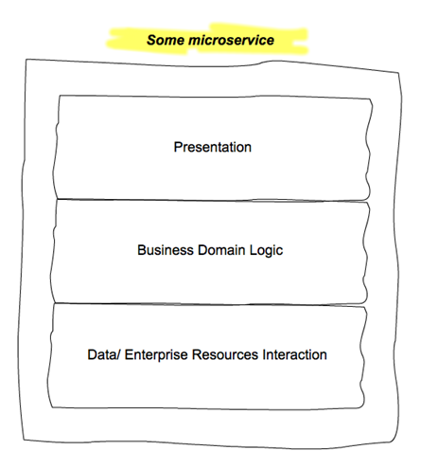
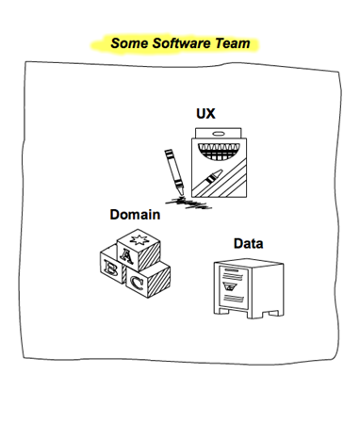

Slide 25
Make Up and Size of Team
The team needs the skills to adhere to our definition.
A mixed skill team
How big is the team?
Varies ☺
Amazon have famous 'two pizza' teams
Copyright KPL KnowledgeSolutions Ltd – All rights reserved

Slide 26
Why Microservices?
In essence microservices are simply opinionated SOA
The style of service as well as message protocols are defined
The big gain is choices of how you build a system
Now or in the future
A toolbox of Lego bricks, each self-contained
The payment is complexity of your system
Particularly when tracing messages through system
Copyright KPL KnowledgeSolutions Ltd – All rights reserved

Slide 27
Should you use Microservices?
Can you answer this question?
What is the end goal for the business?
The one that makes the added complexity worthwhile
Flexibility?
New systems needed that you don't yet know you will need?
Copyright KPL KnowledgeSolutions Ltd – All rights reserved

Slide 28
Microservice Principles
The following slide shows a selection of principles
These should be adhered to when creating microservices
Can you come up with a reason for each?
Can you think of any others?
Copyright KPL KnowledgeSolutions Ltd – All rights reserved

Slide 30
Swagger Demo
The demo will show examples of using the Swagger tool for creating, documenting and distributing microservice style apis

Slide 31
Swagger Activity
You are required to create some appropriate Swagger based apis for the accounts and delivery services from the retail system.
Copyright KPL KnowledgeSolutions Ltd – All rights reserved

Slide 32
Chapter 4: Microservice Design Patterns

Slide 33
Microservice Design Patterns
Design patterns are common in standard OO style systems
Even more useful in microservices
Many small, full stack services needing to inter operate
Need ability to efficiently bring together
And also to break out if problems occur

Slide 34
The Standard Patterns
We'll now work through some standard issues
And define the relevant patterns from first principles
This session is largely demo based
With live coding and group involvement

Slide 35
A Set of Tools
We will cover:
Aggregator
Proxy
Chained
Circuit Breaker
Branch
Shared Data
Asynchronous messaging

Slide 36
Microservice Design Patterns
Do Now
Working from the system explained to you
Come up with some designs on paper or white boards
Which patterns would be of use?
Where?
Using the exercise machine
Implement some of the patterns found above

Slide 37
Chapter 5: NoSQL Datastores

Slide 38
What Is Meant By NoSQL?
Commonly said as "No SQL"
But should be seen as "Not Only SQL"
Adds a set of complimentary ways of storing data
Intended to be used where scale or lack of structure exists
Or indeed the speed of arrival/ reading of data
To use RDBMS generally need different qualities
Defined structures and schemas
Stable relationships and properties
Ability to define indices

Slide 39
Qualities of NoSQL Stores
Aimed at commodity level hardware
Scale out is the standard
Hardware failures are expected and not fatal
Data is commonly denormalised
Store by relevance and association
Streaming becomes an easily used capability
Loose schemas/ No schemas/ Schema on read
Makes changing the structure of the data easy and cheap

Slide 40
Qualities of NoSQL Stores
Rarely expect constraints on uniqueness
Would imply indices that could be checked
Massive data storage and retrieval capabilities
Order of PB and above
Datastores commonly grouped by data storage model
Key-Value
Document
Column Family
Graph

Slide 41
Chapter 6: Key Value Datastores

Slide 42
Key-Value Datastores
Possibly the most common type of NoSQL datastore
Redis commonly used as a general datastore
And as a web cache layer
DynamoDB from AWS very high, maintainable throughput
Riak

Slide 43
Structure of Key-Value Stores
Simplest form of datastore
Nothing more than a key and a value
Similar to a HashTable in a language like Java
Store has no knowledge of structure of value by default
Pure bytes to be stored or retrieved
Standard set of simple, default actions
Get, put, delete
Some stores add others

Slide 44
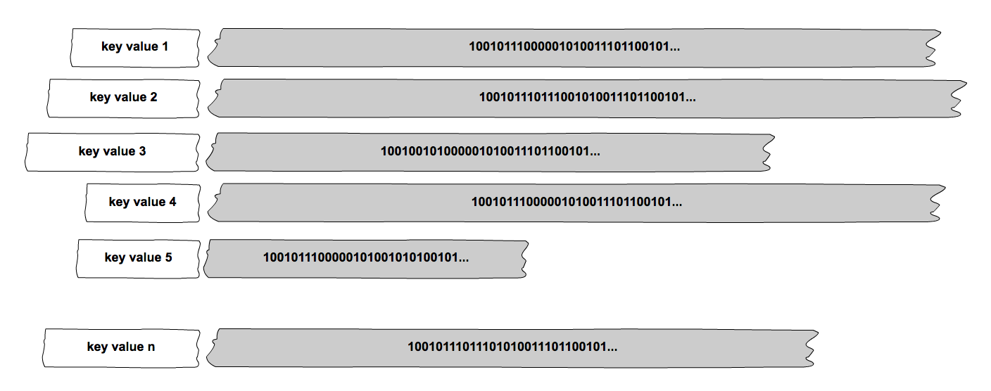

Slide 45
Use Cases for Key-Value Stores
Anything where caching against a key would be beneficial
Session id for web applications
Potentially much faster than an RDBMS and could be in memory
Some hash of user info, though need to beware clashes
Classic shopping cart info
Can be available across machines/ nodes
Avoids need for session affinity
Eases load balancing

Slide 46
Chapter 7: Document Datastores

Slide 47
Document Datastores
Commonly used where the data has an internal structure
That would have to be artificially broken up for an RDBMS
MongoDB probably most commonly used
CouchDB
Terrastore

Slide 48
Structure of Document Stores
A simple form of datastore
Nothing more than a key and a value
Similar to a HashTable in a language like Java
But value is structured
JSON, BSON possibly XML or YAML
Store has knowledge of structure of data
Can query by content
Can retrieve parts of document
Saves machine cycles in application breaking down value

Slide 49
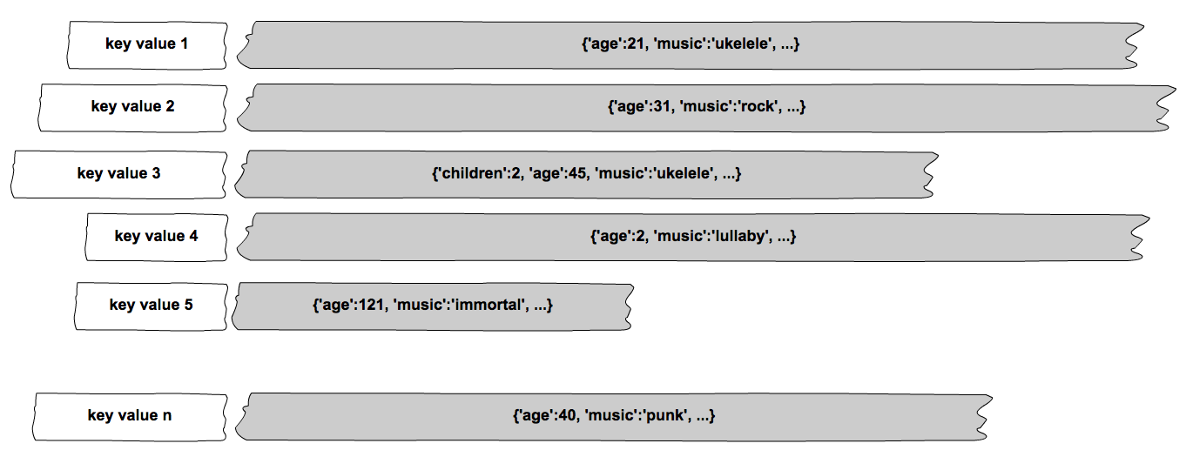

Slide 50
Use Cases for Key-Value Stores
Anything where structure is important
And do not want to break up for RDBMS
Need to keep a flexible schema
'Schema on read'
Anywhere that needs record matching or filtering
Fraud detection systems
End to end transaction matching

Slide 51
Chapter 8: Column Family Datastores

Slide 52
Column Family Datastores
Commonly used where the throughput needs to be high
And data has structure
Cassandra probably most commonly used at time of writing
HBase
Accumulo
Dynamo DB

Slide 53
Structure of Column Family Stores
Avoids problems caused by rectangular tables in RDBMS
In areas where schema can change
In areas where no data would be common in many RDBMS columns
Saves cost of 'wide' tables and large joins
Column family is structured for retrieval
Need to know the most likely ways that it will be used
Data has row keys for initial location of data row
Also column key for location of data value
Columns are actually triples
Column key/ column value/ time stamp of update for column

Slide 54
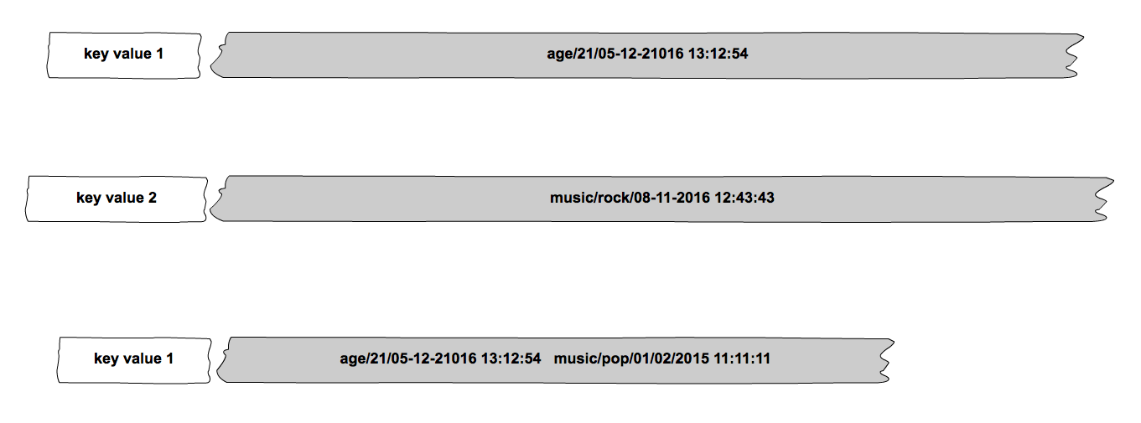

Slide 55
Use Cases for Column Family Stores
Very commonly used in event logging systems

Slide 56
Chapter 9: Graph Datastores

Slide 57
Column Family Datastores
Used where the interest is in the relationships
As well as the data itself
Many available
In the Java world probably most common is Neo4J
Flock
Infinite Graph

Slide 58
Structure of Graph Stores
Data is stored as a collection of nodes and relationships
Nodes can be structured data, as can the relationship
Underlying processes rely on graph theory
The nodes represent 'items or 'entities'
For example a cricket team
Has a set of properties to hold data
Can be grouped into sets
Relationships connects the nodes
Allows traversal
Gives some structure to the graph overall

Slide 59
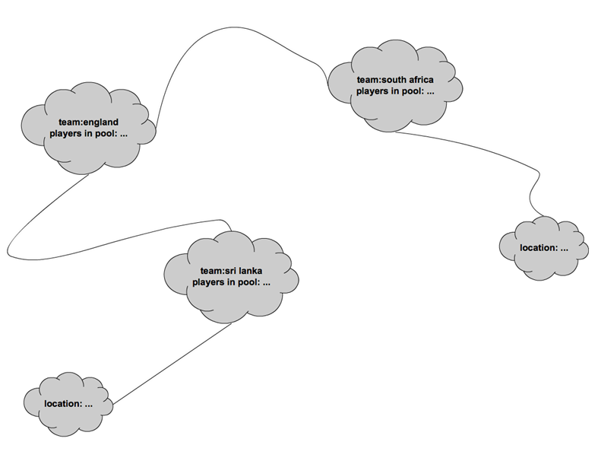

Slide 60
Use Cases for Graph Stores
Very commonly used in recommendation engines
Neighbourhoods can be created by traversing relationships
Very useful where the question is based on the relationship
Shortest journey type questions

Slide 61
Datastores
Do Now
Working from the system explained to you
Which datastores would be of use?
Where?
Why did you pick those one(s)?
Using the exercise machine
Implement some of the datastores decided on above

Slide 62
Chapter 10: Docker

Slide 63
Docker
Docker is a software containerisation platform
A container is a complete filesystem which contains a software application and all of its dependencies
Containers isolate applications from each other and the rest of the system
Containers are secure as they confine software into a jail
Copyright KPL KnowledgeSolutions Ltd – All rights reserved

Slide 64
Running Docker on Linux
Docker was originally a Linux application
It uses the kernel container functionality
We will be running our Docker images on Linux
Docker uses a client-server architecture
Docker registries are public or private repositories of Docker images
Copyright KPL KnowledgeSolutions Ltd – All rights reserved

Slide 65
Images versus Containers
Docker images are read-only templates
Built from cut down versions of Linux Applications are installed into images
Docker containers are like directory structures
A container holds everything required for an application to run
Every container is created from a Docker image
They can be run, started, stopped and deleted
Copyright KPL KnowledgeSolutions Ltd – All rights reserved

Slide 66
Docker Demo
This will be a live demo of how to create, run and interact with a Docker machine for the exercises
Copyright KPL KnowledgeSolutions Ltd – All rights reserved

Slide 67
Chapter 11: Docker Swarm

Slide 68
Docker Swarm – What is it?
Docker Swarm is clustering for Docker
It turns several Docker hosts into a single virtual Docker host
The Swarm is controlled by a Swarm Manager
Each Docker node communicates with the manager
A machine needs to be designated as a manager
There can be several managers
The manager is created by initialising a Swarm
It must be performed on the manager machine
Copyright KPL KnowledgeSolutions Ltd – All rights reserved

Slide 69
Swarm Services
A Docker Service is a container
Services run in Docker Swarm
They can only be started on a Swarm Manager node
Multiple copies of services can be run
The Swarm Manager replicates the service on other nodes in the Swarm
A service can be scaled
The service will be duplicated and run on different nodes
Copyright KPL KnowledgeSolutions Ltd – All rights reserved

Slide 70
Docker Swarm Demo
This will be a live demo of how to create, run and interact with a Docker Swarm for the exercises
Copyright KPL KnowledgeSolutions Ltd – All rights reserved

Slide 71
Chapter 12: Docker Compose

Slide 72
Docker Compose
Docker compose is a tool for running multi-container Docker applications
A configuration file is used to define the services
All of the services can be run using a single command
Compose can manage the lifecycle of an application
Start stop and rebuild services
Get the log output of running services
Copyright KPL KnowledgeSolutions Ltd – All rights reserved

Slide 73
Running Compose
Create a directory for Docker Compose
Create a YAML file called docker-compose.yml
The docker-compose command needs to be run from the directory containing the YAML file
Docker Compose has an up option which runs all containers
The down option terminates all managed containers
Copyright KPL KnowledgeSolutions Ltd – All rights reserved

Slide 74
Docker Compose Demo
This will be a live demo of how to create, run and interact with a Docker Compose set of machines for the exercises
Copyright KPL KnowledgeSolutions Ltd – All rights reserved

Slide 75
Chapter 13: SAM and Reactive Systems

Slide 76
SAM and Reactive systems
Modern systems are increasingly being written to react
They await an event, check a condition evoke an action
In Java this was originally carried out via SAM methods
Single Abstract Method
Allied with anonymous inner classes
Now often carried by use of Lambdas
Internal to the codebase
Java 8, Scala etc.
External to the codebase
AWS Lambdas
Copyright KPL KnowledgeSolutions Ltd – All rights reserved

Slide 77
AWS Lambdas
This will be a live coding session on how to use the various types of reactive code available to us. This will include a mix of AWS Lambdas and AWS SNS to react to, and notify of, several scenarios.
Copyright KPL KnowledgeSolutions Ltd – All rights reserved

